Slide 1

Primer for using Mixamo animations & models in Unity
October 2020

Slide 2
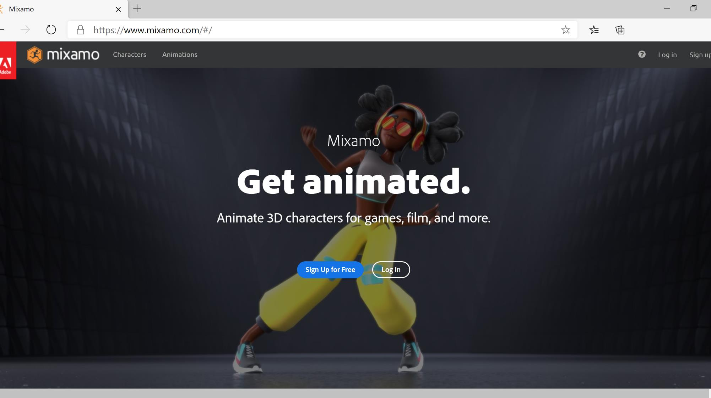
Adobe Mixamo

Slide 3
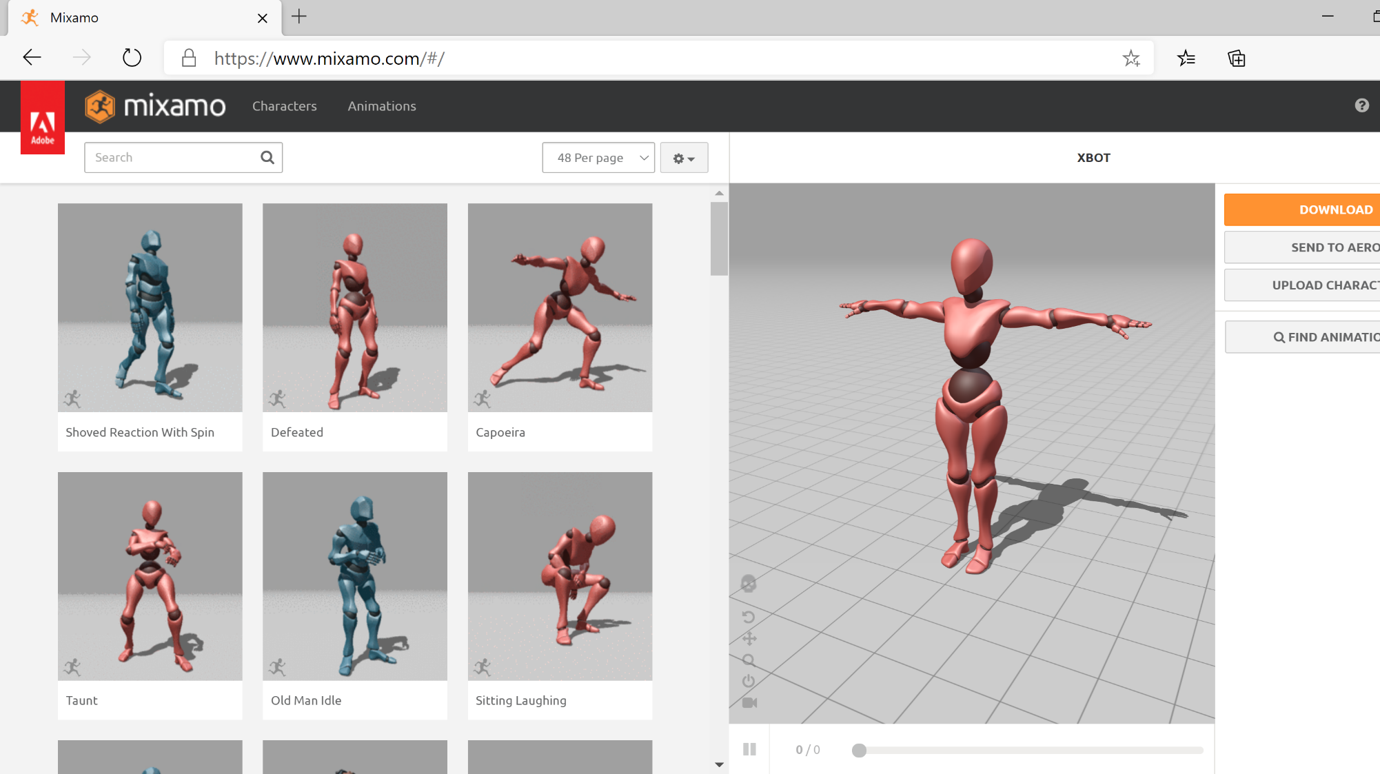
First Screen After Logging In To Mixamo

Slide 4
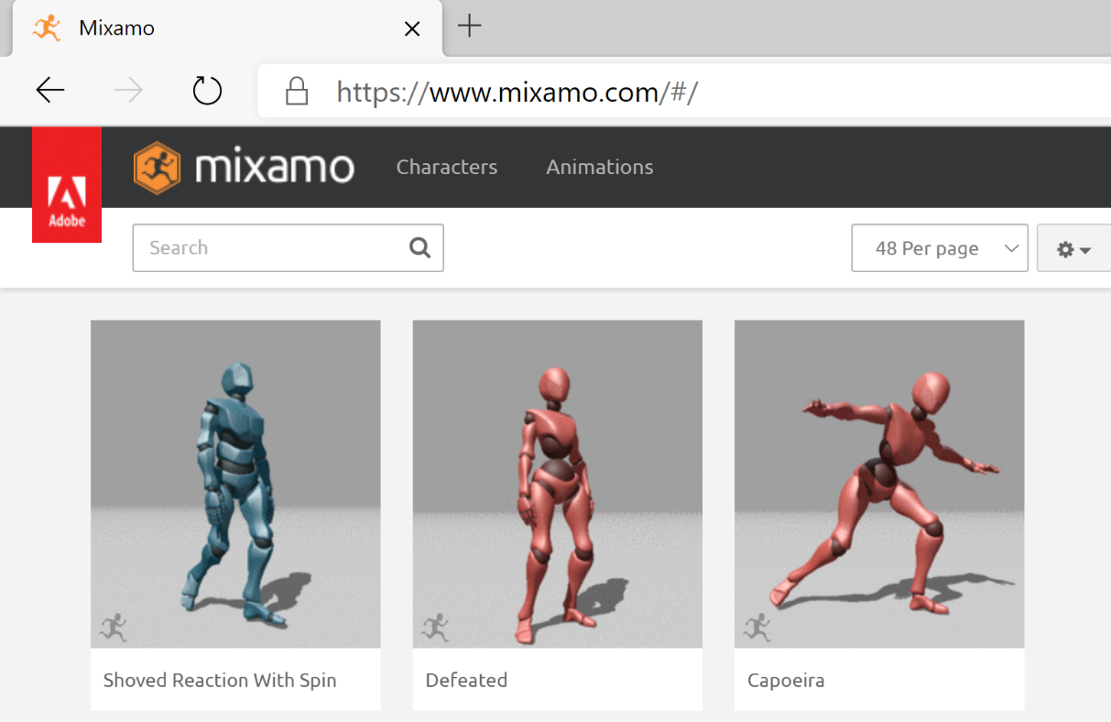
Select Characters or Animations
Stock Characters
Stock Animations

Slide 5
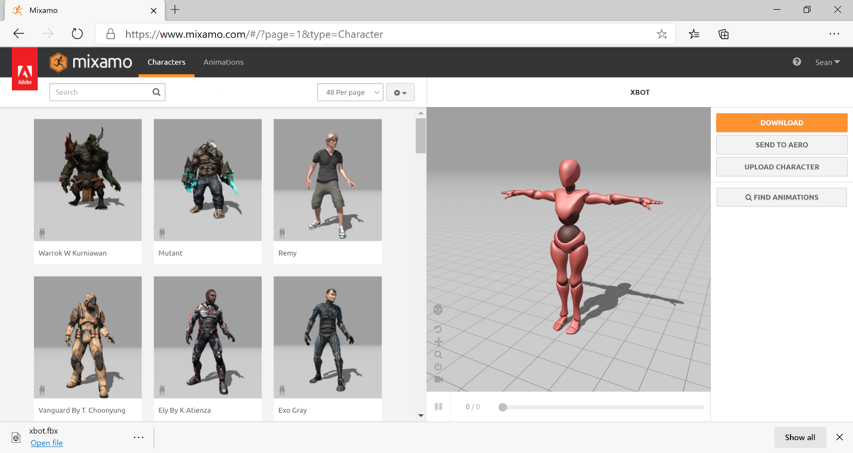
After Choosing Characters
Character Options
Chosen Character

Slide 6
Once Character Chosen Switch to Animations
Stock Characters
Stock Animations

Slide 7
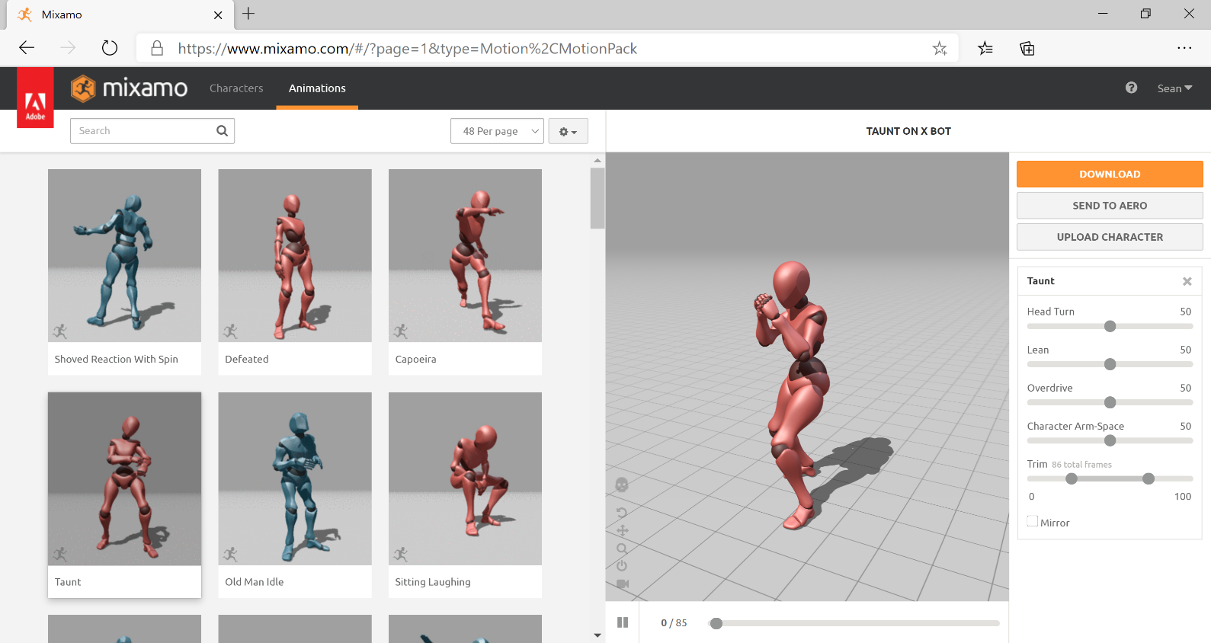
Download an Animation
Download selected animation
Animation Options
Animation Applied to Model

Slide 8
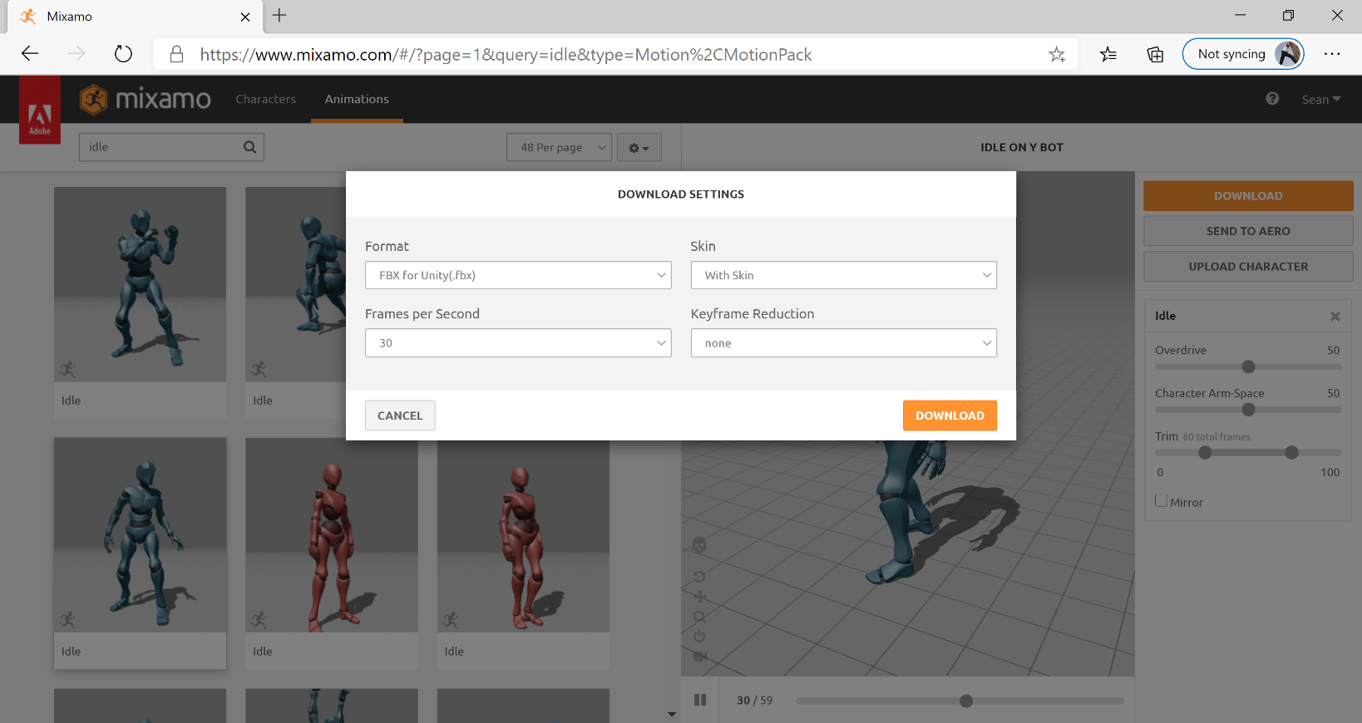
Select Animation Format
Use “FBX For Unity (.Fbx)” if working with unity.
With Skin if you want to download the model with the animation. Otherwise, without.

Slide 9

Open Unity
Load your unity project or create a new one.
We will assume you have an existing scene setup.
Open the scene you want to work in.

Slide 10
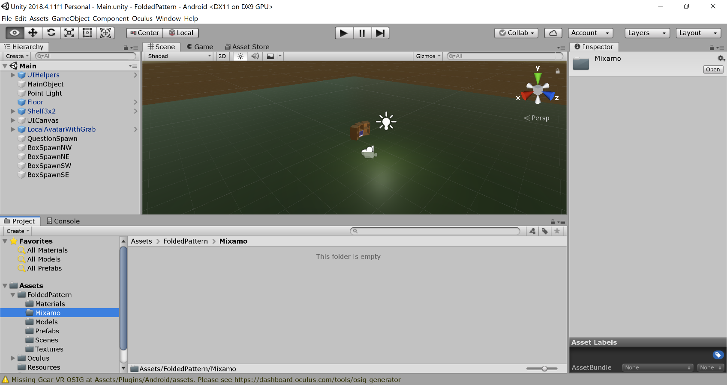
Create Assets Folder for Mixamo Imports
Folder can be any name, I call it Mixamo so I know what I got from where.

Slide 11
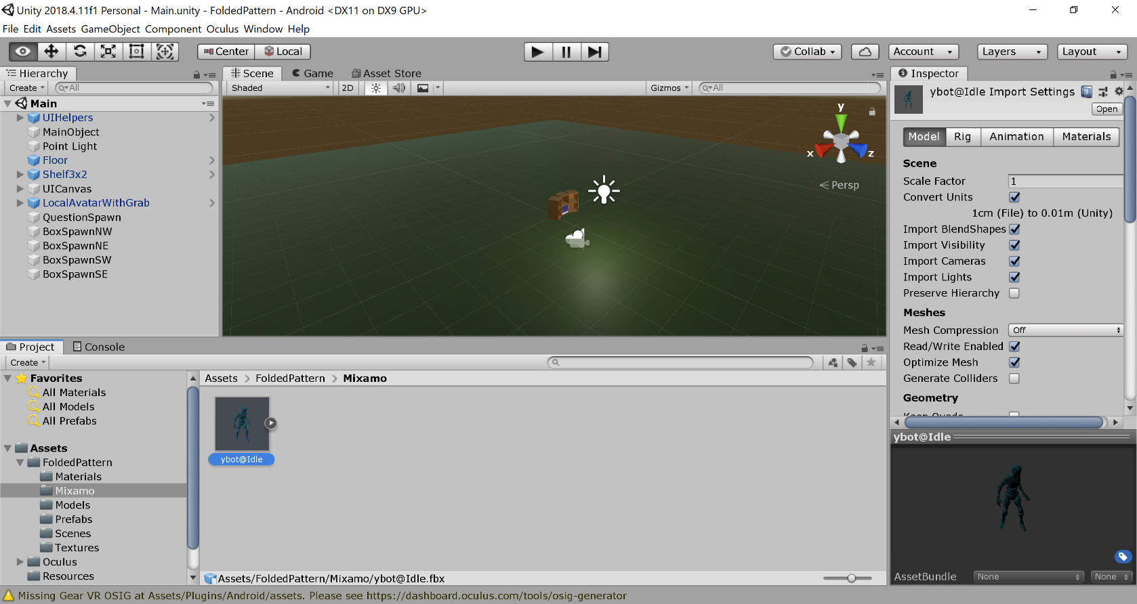
Import Character and Animation into Unity
Drag the items you downloaded from Mixamo into the new Mixamo folder you made.
Animation w/ Imported Skins

Slide 12
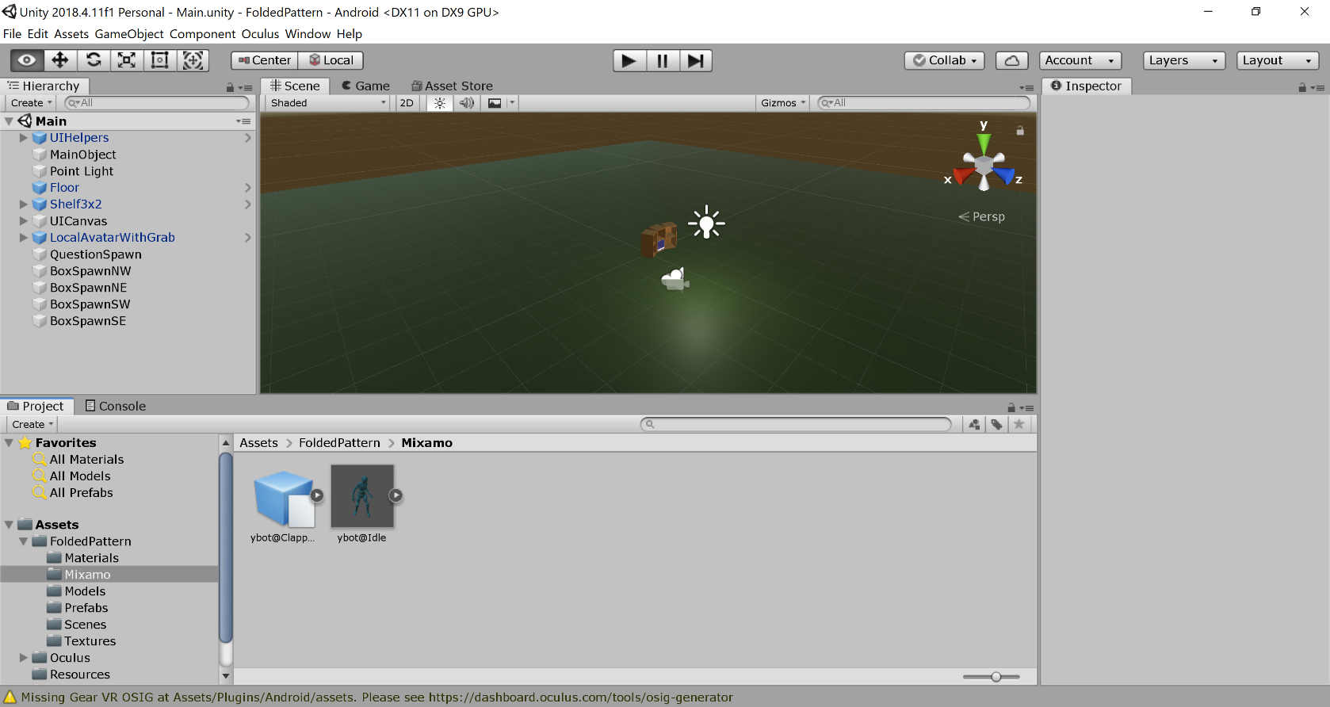
Import Any Additional Animations
Imported animations without skins

Slide 13
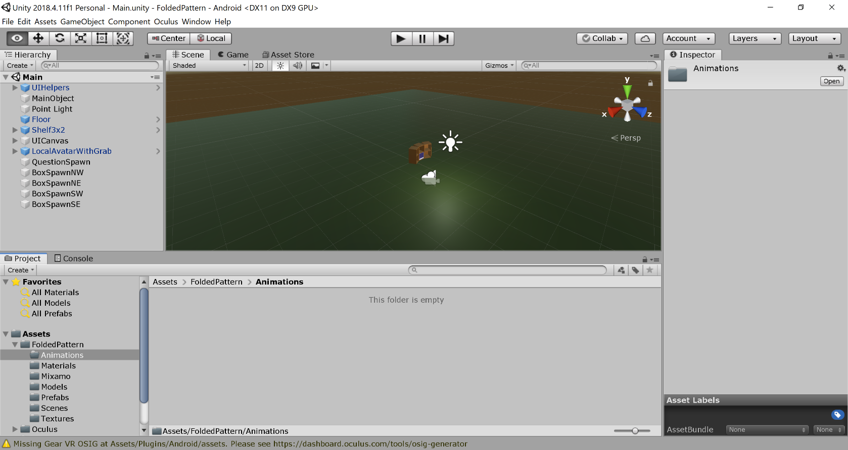
Create Animations Folder
Create folder to house the animations and the animation controller that will be discussed later.

Slide 14
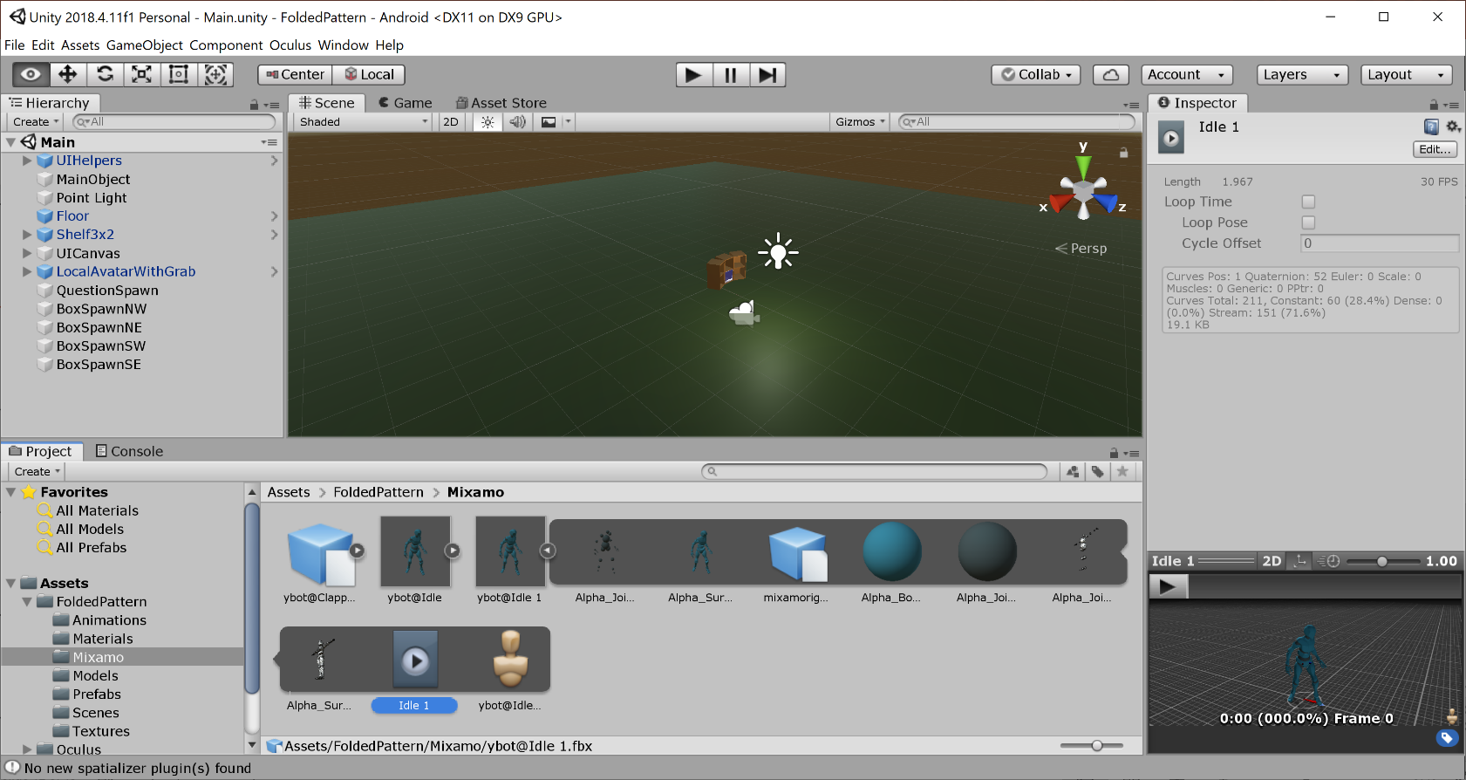
Animation
Go back to the Mixamo folder to see what we downloaded from Mixamo earlier.
This is the animation portion of the “animation with skin” after pressing “arrow” icon to expand what we downloaded

Slide 15
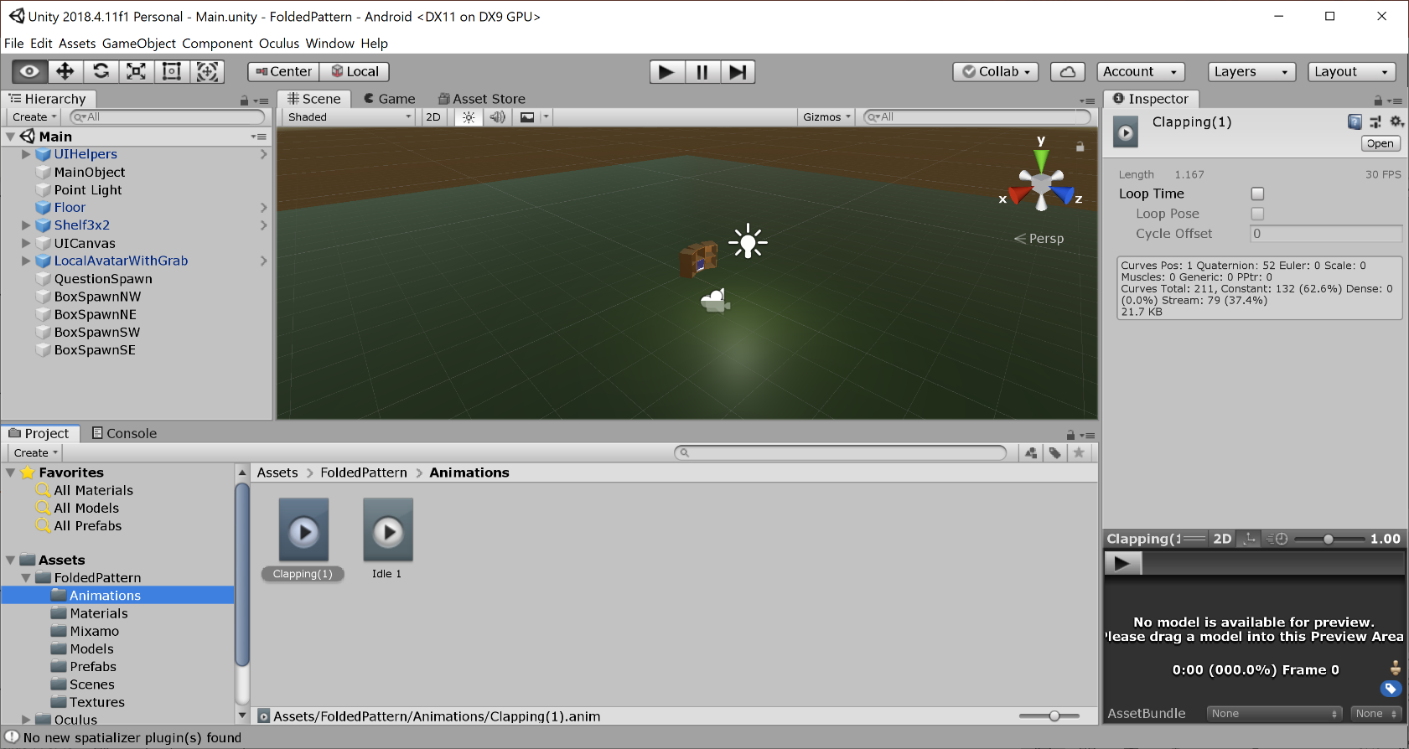
Move Animation Components Download from Mixamo to Animations Folder
Select just the animation portions of the data from Mixamo (in Mixamo folder).
Press “ctrl + D” to duplicate them.
Drag duplications to animations folder.
Final result something like shown.

Slide 16
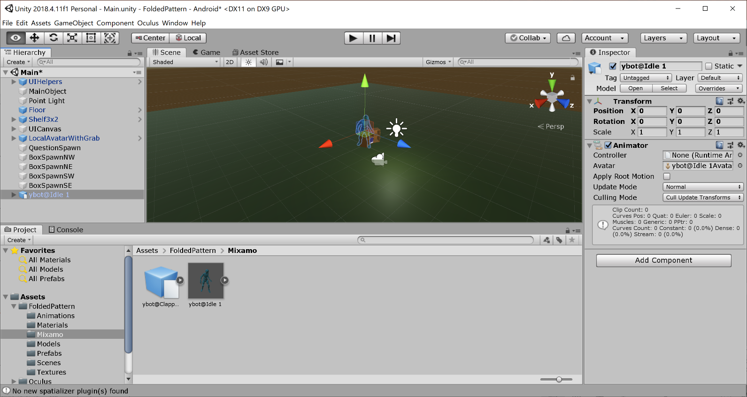
Add Model to Scene
Drag model from Mixamo asset folder to hierarchy tree
Adjust position of model in scene
Delete any spaces in name before modifying the code later

Slide 17
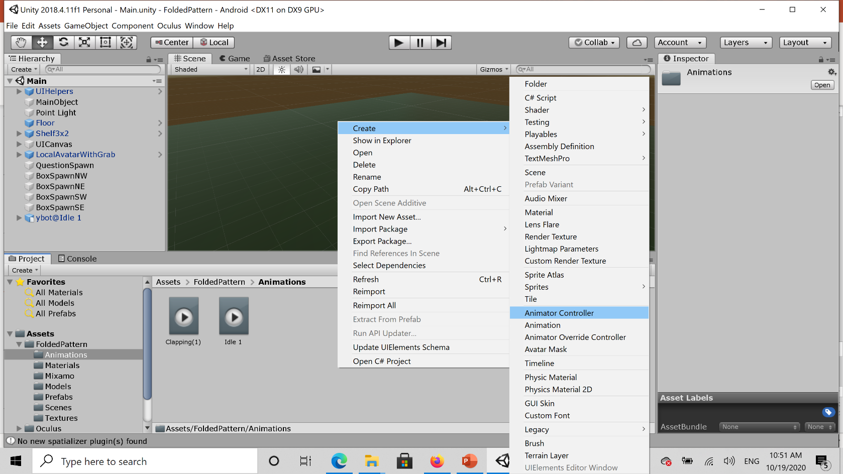
Animator (Make Animation Controller)
Right click in animations folder, go to create, select “animator controller”

Slide 18
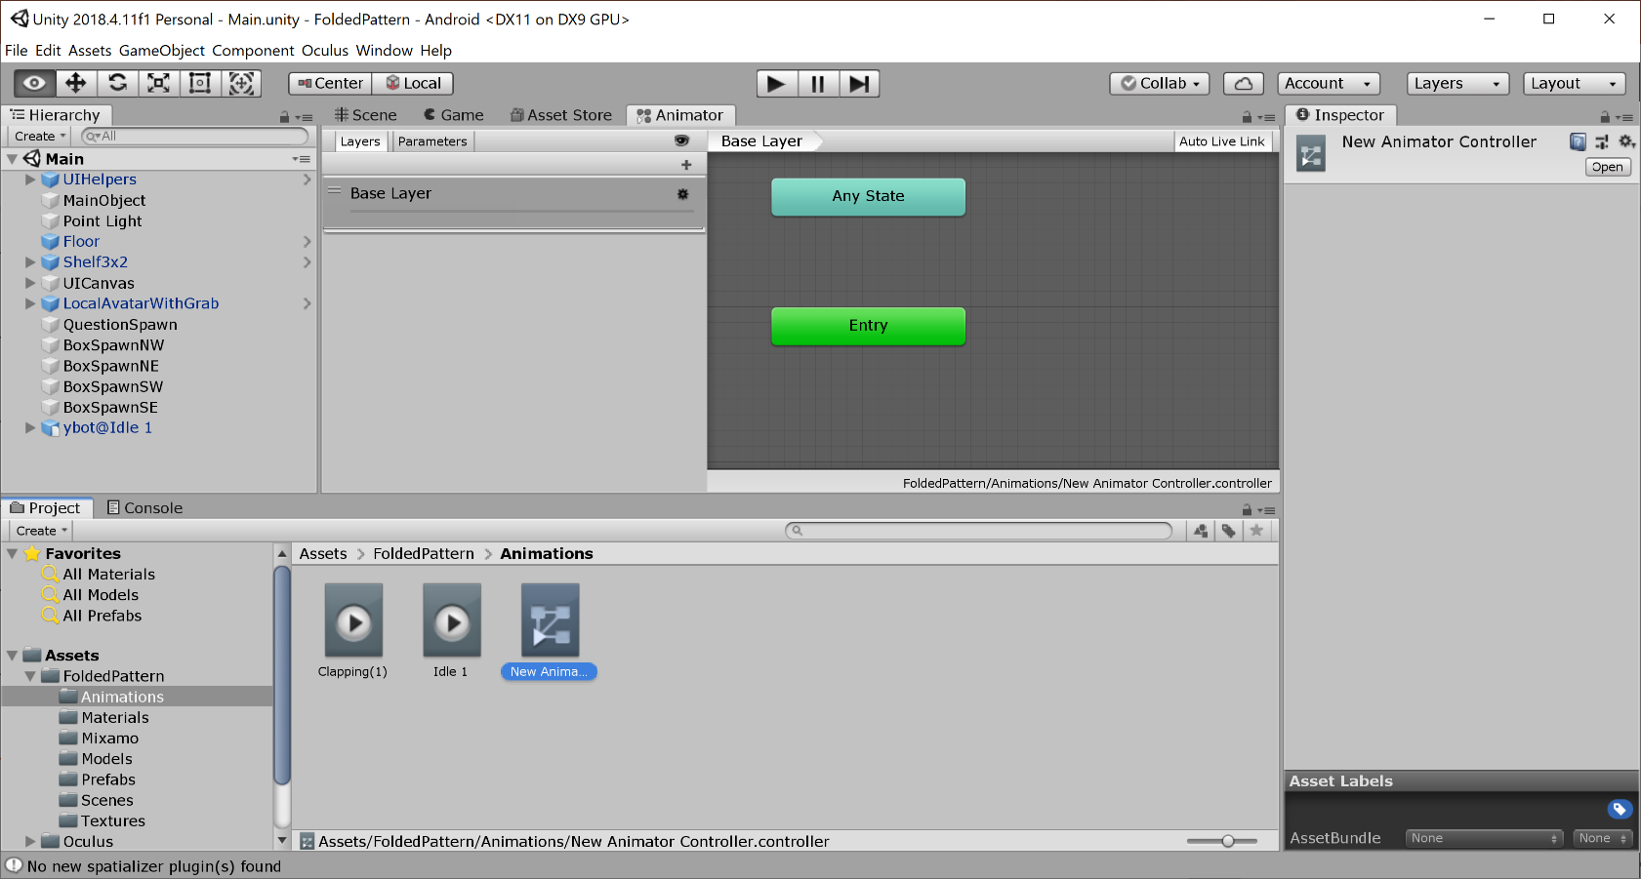
Open Animator Controller
The controller can be named whatever you like

Slide 19
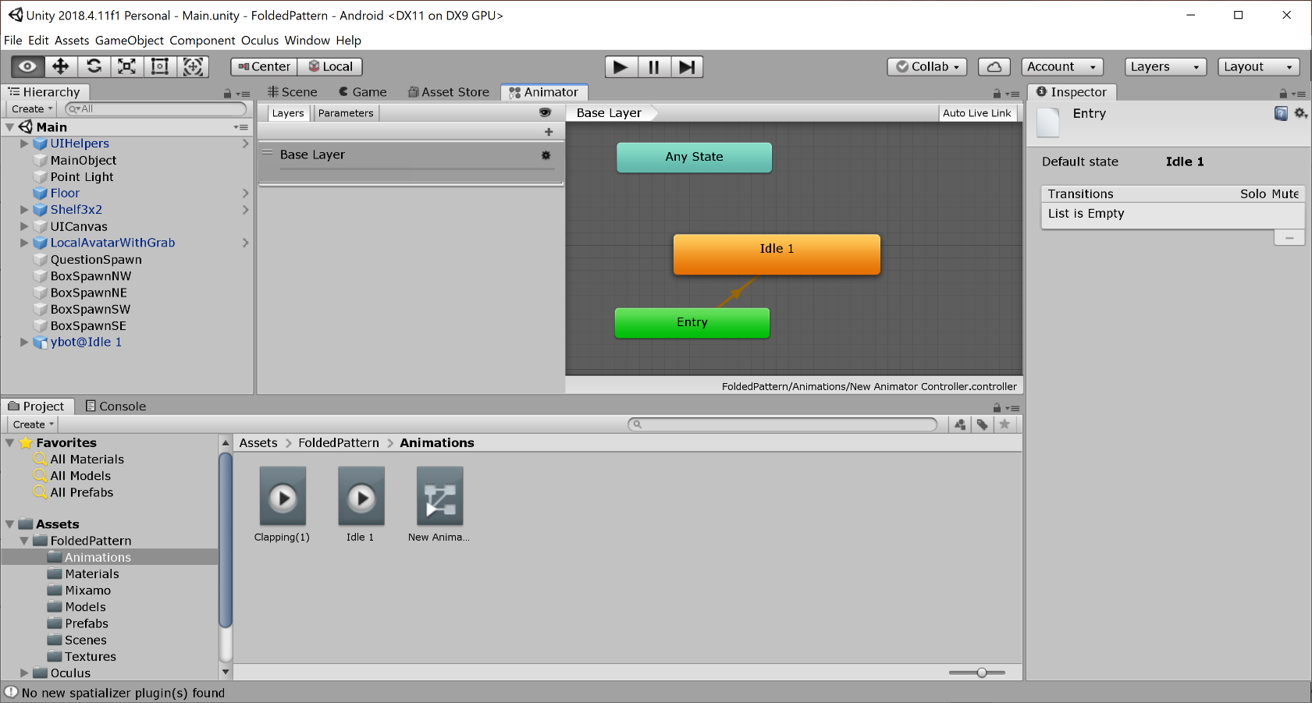
Add Animation State to Controller
Click animation and drag to add animation state

Slide 20
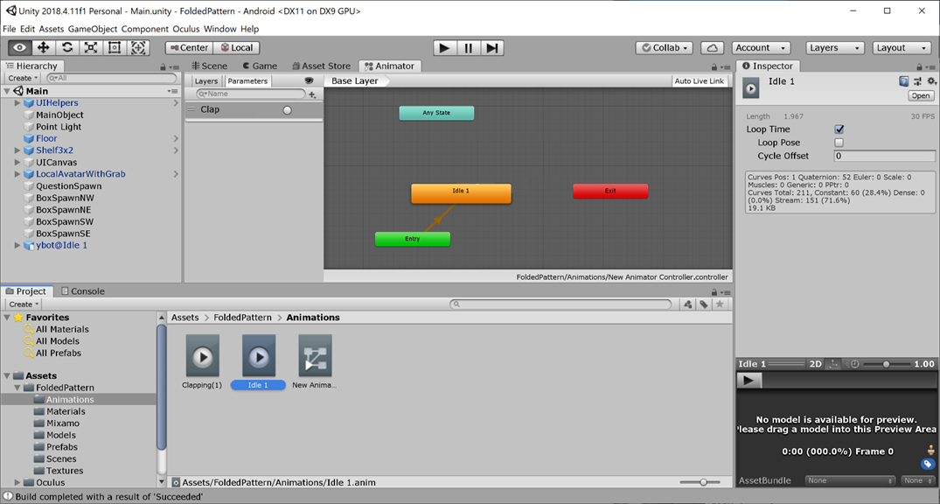
Make Animation Repeat
Check “loop time” box in inspector after clicking on the “Idle 1” asset.

Slide 21
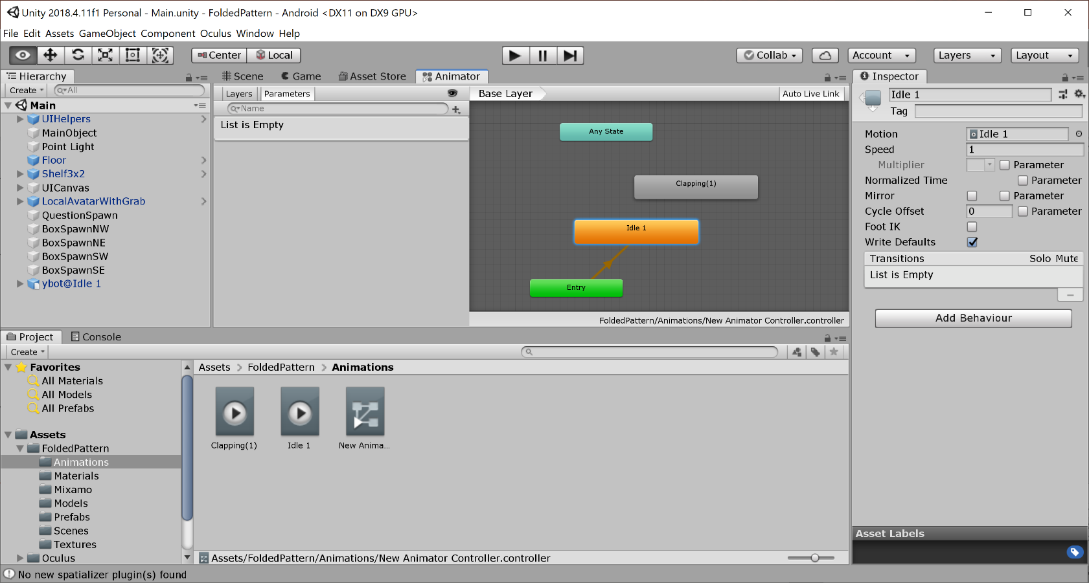
Add Additional States
Drag in additional animations. The orange one is the default state.

Slide 22
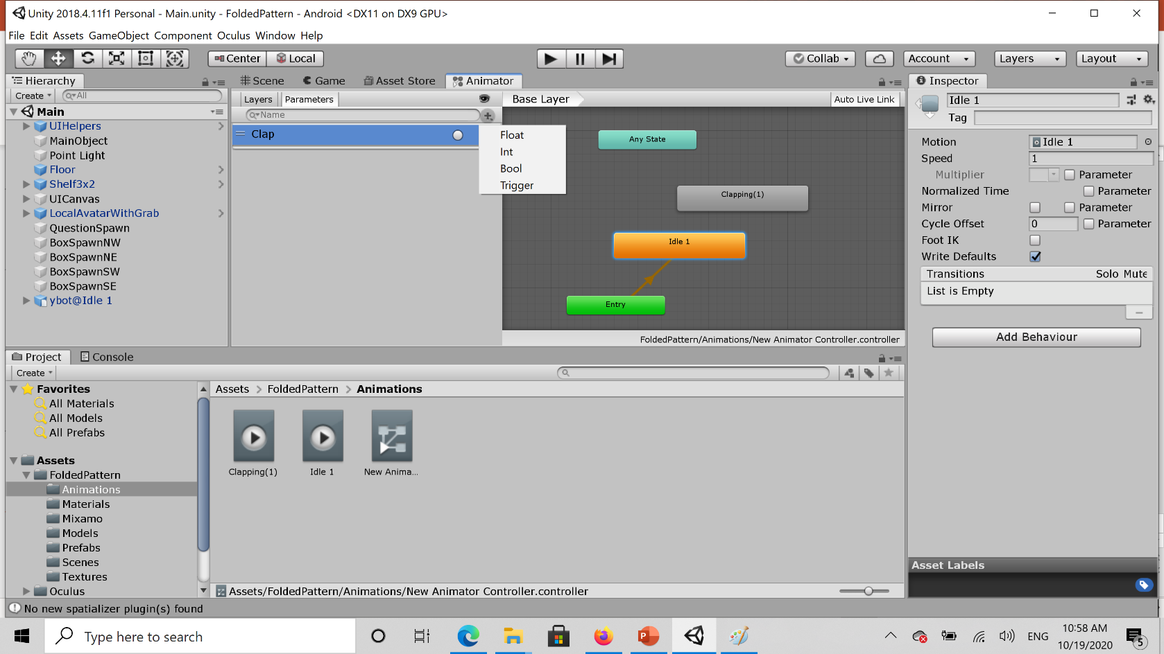
Add Trigger
In parameters tab click the plus sign and select trigger. Name it something you like.
Triggers are used to transition between states. They only fire once unlike “Bool”

Slide 23
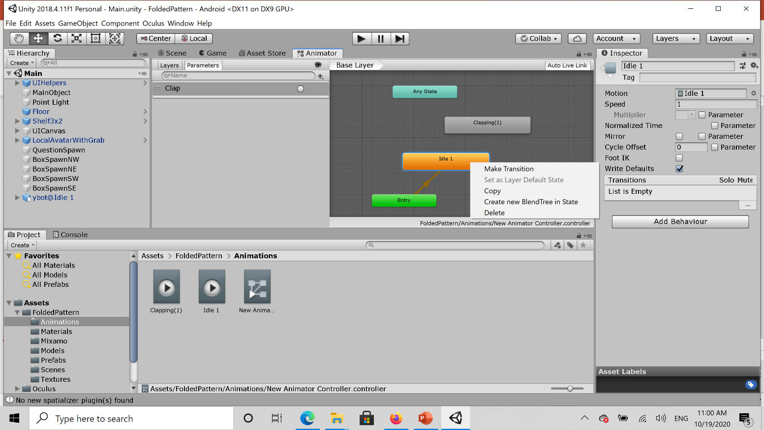
Add Transition
Right click on state and select “make transition” and drag arrow to next state you want to transition to.

Slide 24
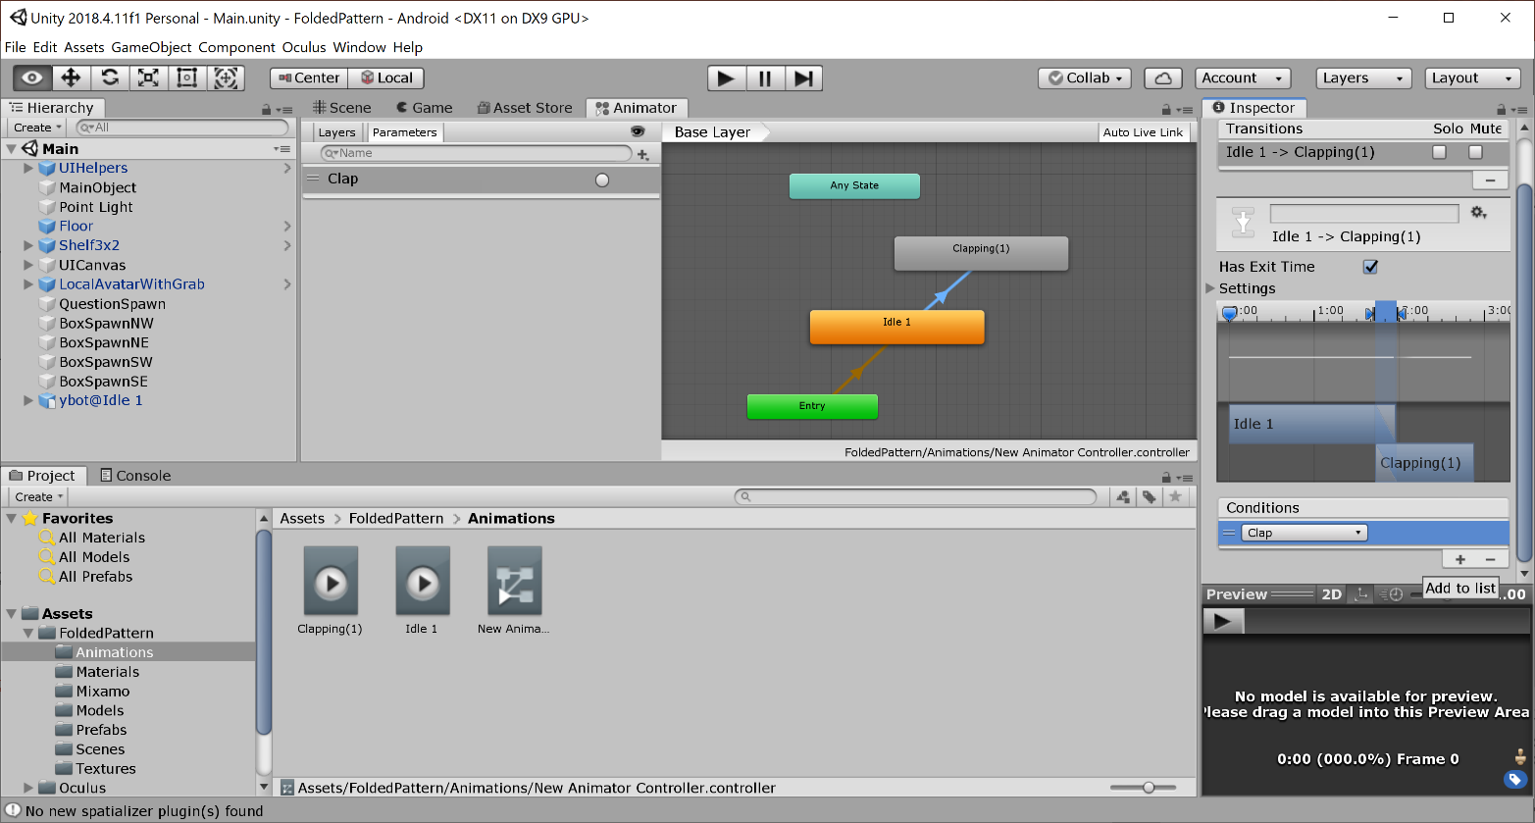
Apply Trigger to the Transition
Click on transition arrow, scroll to “condition” select the plus and add the trigger you want to use (clap in our case).
Whenever the “clap” variable is true, the animation will be triggered.

Slide 25
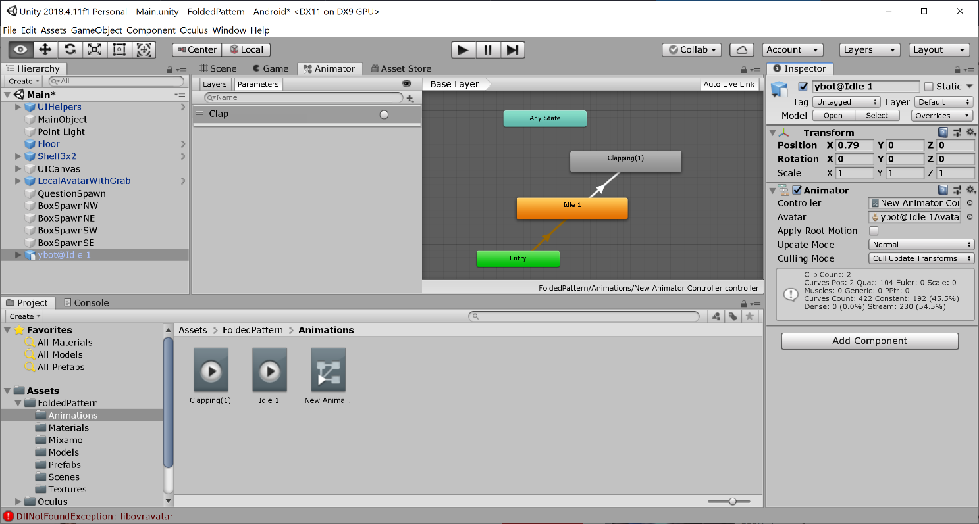
Apply Animator Controller to Model
Click on model and look at the inspector
Drag the animation controller into the “controller” box of the inspector.

Slide 26
Build and Run
Build and run your game, you will see your character in the scene preforming the default animation. In our case this was Idle 1.
Now work on the code in order to use the trigger we defined. By using the trigger we can make the animation change states.

Slide 27
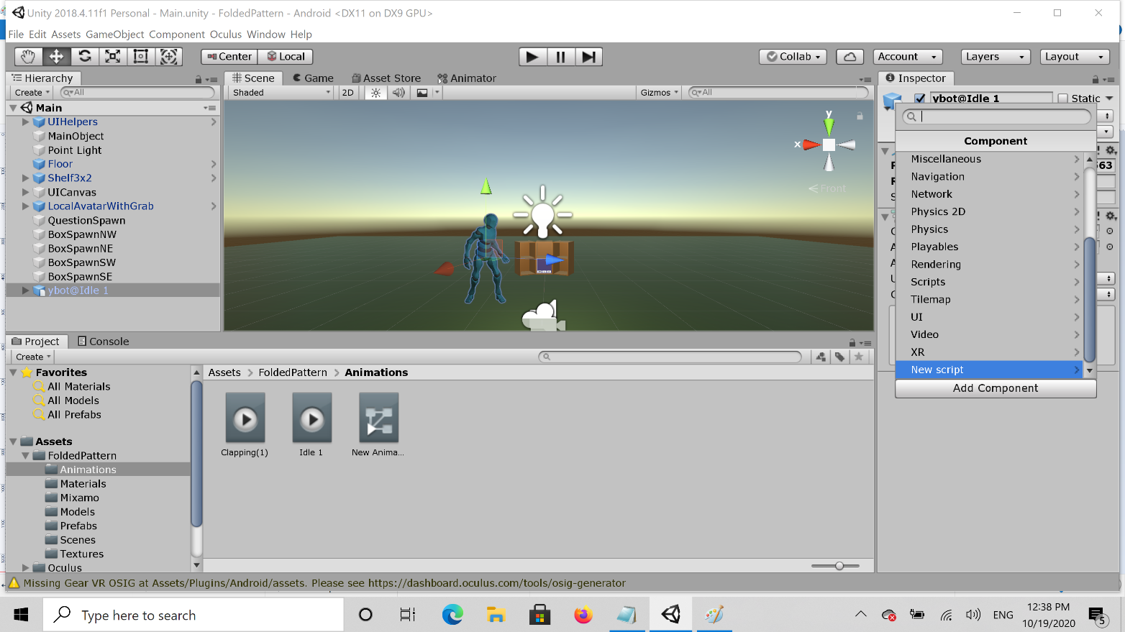
Add New Script to Model Controller
New script used to access the triggers setup previously while in game.
Select GameObject (ybot@idel1 in our case). In the inspector Press “add component” and go to “new script”

Slide 28
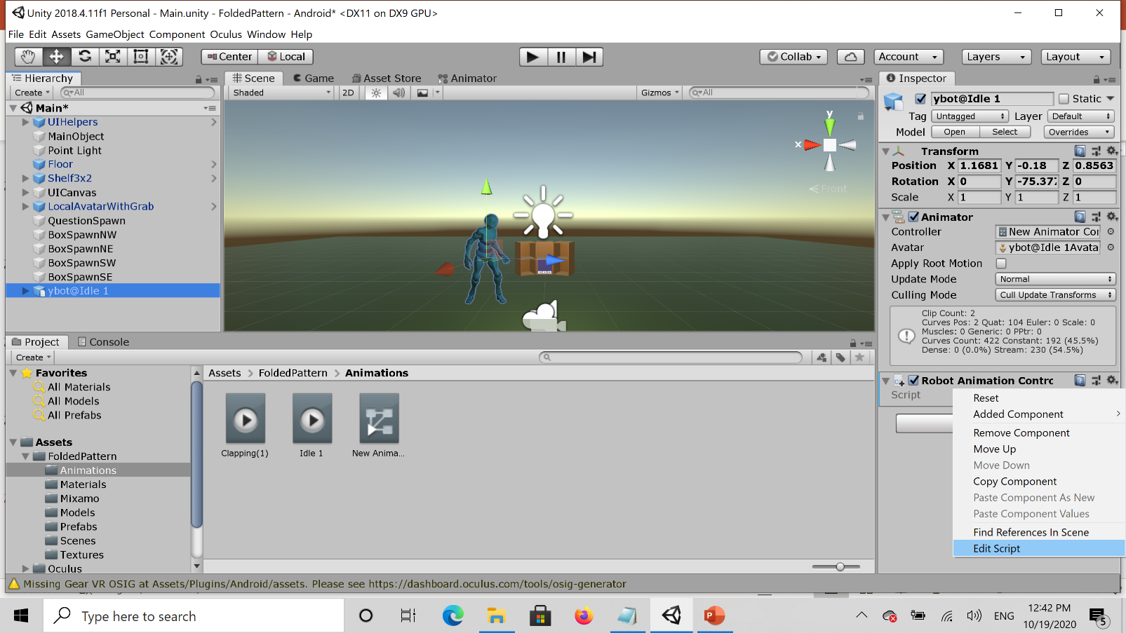
Make New Script Attached to Robot Model
Now on the script press the gear icon and go to edit script

Slide 29
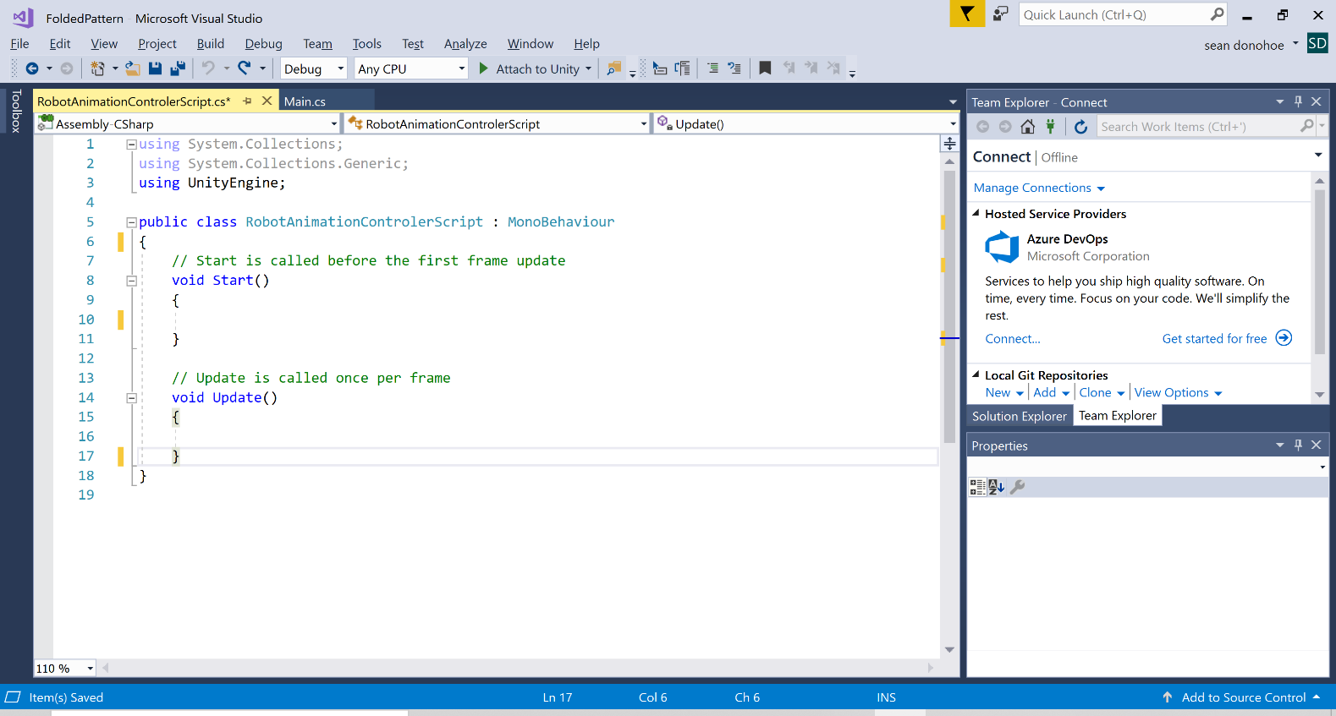
New Code to Edit
This is the blank script looks like that has now been generated.
In my case it is opened in Microsoft Visual Studio. You can use any editor you like.

Slide 30
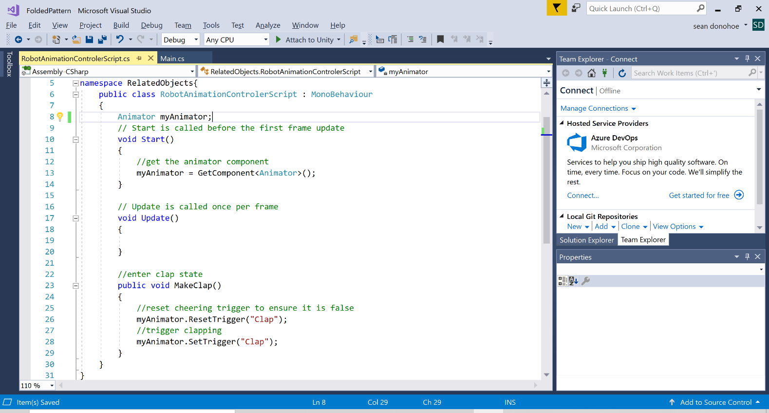
Edit Code
Add to namespace
Declare Animator.
In Start() method get the animator component.
Create new method MakeClap() to change trigger variables. (name of method is up to you)

Slide 31
Modify Main Script
//make Object
private RobotAnimationControlerScript myBotController = null;
//Find robot GameObject and get script from it
private void Awake(){
GameObject robot = GameObject.Find("/ybot@Idle1");
myBotController = robot.GetComponent<RobotAnimationControlerScript>();
}
//Insert into code section that runs when correct answer selected
myBotController.MakeClap(); //make robot clap

Slide 32
Improving the Animation
At this point the character will clap when a correct answer is selected, but they will stay in the clapping state. We can go back to the animation controller to fix this.

Slide 33
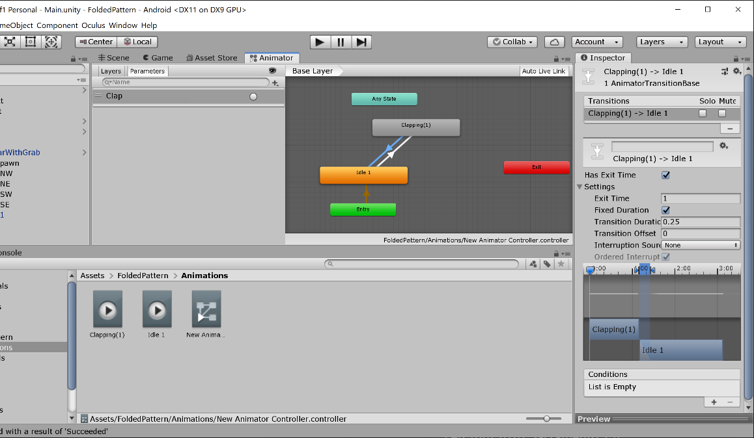
Adding Another Animation Transition
Add a new transition from “clapping” back to “idle” (see previous slide on how to add transitions)
Click on the transition and look at “settings” in the inspector. Setting the “exit time” to 1 will make this transition happen once the clapping animation has finished.

Slide 34
Conclusion
At this point you should have a basic animation working. The character should stand idle until you select the correct answer and then clap. Once done clapping, they will go back to being idle.
From this point you can modify the code and the animation controller to make far more complex actions.

Slide 35
References
Many helpful YouTube videos and internet resources exist on this process.
A good reference with a process very similar to that discussed here can be seen in https://www.youtube.com/watch?v=vApG8aYD5aI&t=334s and https://www.youtube.com/watch?v=FF6kezDQZ7s&t=333s
Also see Unity documentation such as https://docs.unity3d.com/ScriptReference/Animator.Play.html

